Slide 1
DREAMHACK LEADERBOARD [ 1st DAY, DUO ]
자신이 여러팀 소속일 수있음
122 nickname1 nickname2 123 pts 100 pts 23 pts
RANK | TEAM | | OVERRALL PTS | RANK PTS | KILL PTS | xxx pts
---------------------------------------------------------------------------------------------------------
1 nickname1 123 pts 100 pts 23 pts
nickname2
---------------------------------------------------------------------------------------------------------
2 nickname3 120 pts 110 pts 23 pts
nickname4
---------------------------------------------------------------------------------------------------------
3 nickname3 120 pts 110 pts 23 pts
nickname4
---------------------------------------------------------------------------------------------------------
4 nickname3 120 pts 110 pts 23 pts
nickname4
---------------------------------------------------------------------------------------------------------
여러 page 지원해야함…

Slide 2
DREAMHACK LEADERBOARD [ 2nd DAY, SQUAD ]
122 nickname1 nickname2 123 pts 100 pts 23 pts
nickname2 nickname2
RANK | TEAM | OVERRALL PTS | RANK PTS | KILL PTS
---------------------------------------------------------------------------------------------------------
1 nickname1 nickname2 123 pts 100 pts 23 pts
nickname2 nickname2
---------------------------------------------------------------------------------------------------------
2 nickname3 nickname2 120 pts 110 pts 23 pts
nickname4
---------------------------------------------------------------------------------------------------------
3 nickname3 nickname2 120 pts 110 pts 23 pts
nickname4 nickname2
---------------------------------------------------------------------------------------------------------
4 nickname3 nickname2 120 pts 110 pts 23 pts
nickname4 nickname2
---------------------------------------------------------------------------------------------------------

Slide 3
DREAMHACK LEADERBOARD [ 2nd DAY, SQUAD ]
TEAM nickname1 nickname2 nickname3 nickname4
RANK : 12
TEAM SCORE : 123
…
TIME | RANK | KILL | OVERRALL PTS | RANK PTS | KILL PTS
---------------------------------------------------------------------------------------------------------
12:21 | 1 12 11 10 1
12:21 | 1 12 11 10 1
12:21 | 1 12 11 10 1
12:21 | 1 12 11 10 1
12:21 | 1 12 11 10 1
12:21 | 1 12 11 10 1
12:21 | 1 12 11 10 1
12:21 | 1 12 11 10 1
12:21 | 1 12 11 10 1
BEST 3 RECORD

Slide 4
LEADERBOARD RULES
……………..

Slide 5
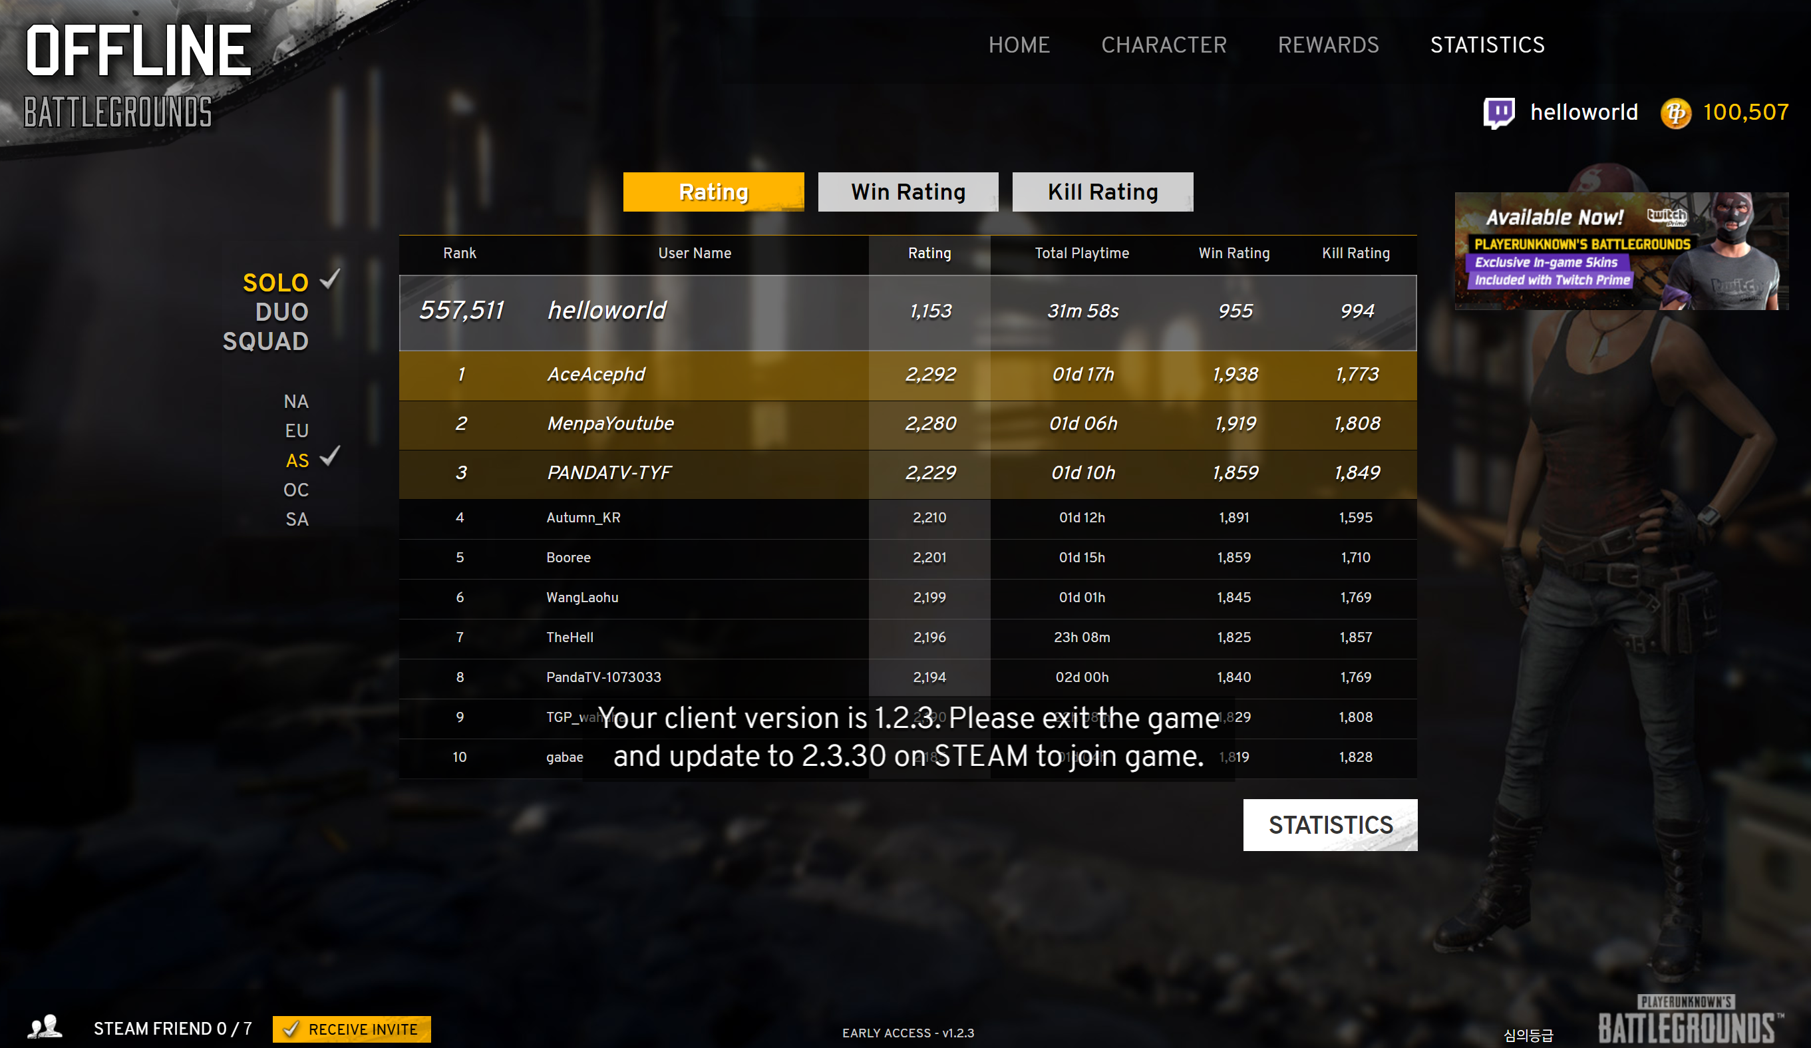
DREAMHACK LEADERBOARD
DREAMHACK
LEADERBOARD

